Slide 1
Covid19 global fingerprint
Prakruthi Burra, Izan Chalen, Rafael J. Gonzalez-Ricon,
Dave D. Istanto, Katiria Soto-Díaz

Slide 2
General strategy
Fenotypical Analysis
Genotypical Analysis
Data recompilation: Mortality, incidence, recovery
Social effect in epidemiology: Temperature, Economical, hospital accessibility, pollution level (Most affected countries)
Geomap: Mortality, Incidence, Recovery
Alignment 400+ sequences (Gene identification)
Essential genes identification→ Covid2
Comparison: coding region variants
Distribution of hotspot missense mutations in different countries
Distribution and the allele frequencies in different countries
Geomap of mutations

Slide 3
Fenotypic Analysis

Slide 4
Epidemiological Approach
Mortality
Incidence
Resistance

Slide 5
Genotypic Analysis

Slide 6
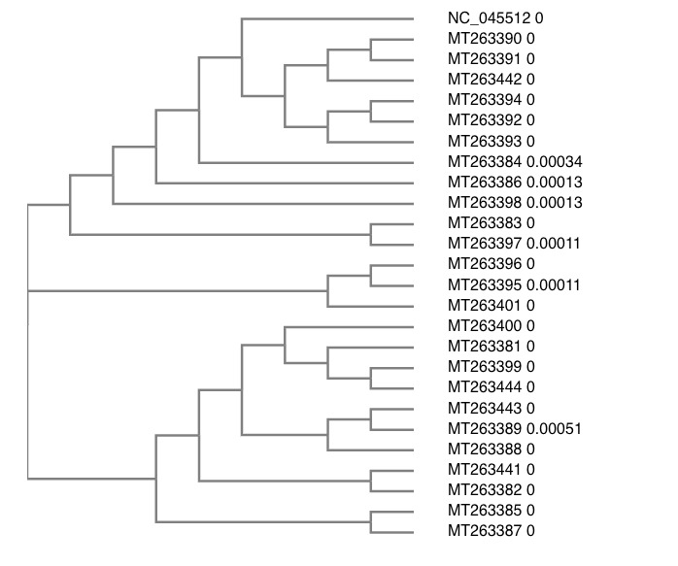

Slide 7
COVID2- Essential Genes
Gene | Function
Ace2 | Transmission and cell entry
RBD | receptor binding domain in the spike protein
NSP2/3 | Infection capability and differentiation
pp1a | no structural proteins
pp1ab | no structural proteins
DPP4 | enhance entry
APN | enhance entry
TMPRSS2 | cleavage of trimmer S protein
cathepsin | endocytosis
TLR3/7/8/9 | sense genome in the endosome
RIGI | recognition of viral genome in the cytoplasm
MDA5 | recognition of viral genome in the cytoplasm
cGAS | recognition of viral genome in the cytoplasm
TRIF | complex signaling recruitment adaptor
MAVS | complex signaling recruitment adaptor
STING | complex signaling recruitment adaptor
MyD88 | complex signaling recruitment adaptor
NFkB | complex signaling recruitment adaptor
IRF3 | complex signaling recruitment adaptor
IFNa/b | complex signaling recruitment adaptor
Mutation detection across all the sequences

